Slide 1
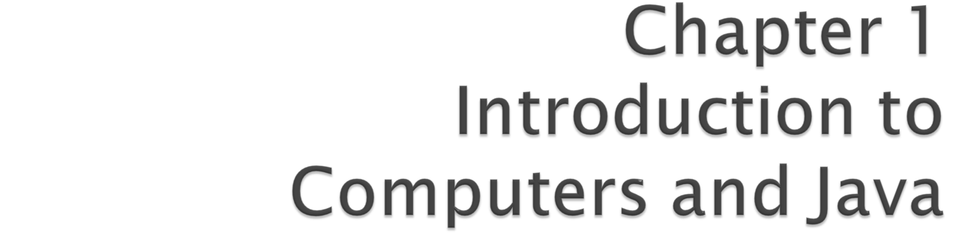
Java How to Program, 9/e
©1992-2012 by Pearson Education, Inc. All Rights Reserved.

Slide 2
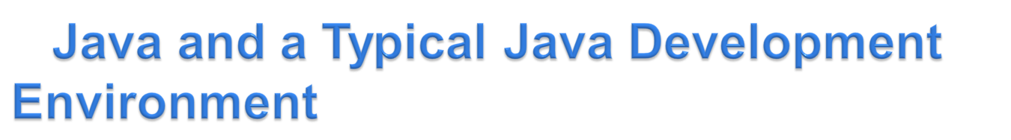
In 1991, Sun Microsystems developed a C++-based object-oriented programming language called JAVA.
  Key goal of Java is to be able to write programs that will run on a great variety of computer systems and computer-control devices – a characteristic of programs called portability
  This is sometimes also called “write once, run anywhere.”
©1992-2012 by Pearson Education, Inc. All Rights Reserved.

Slide 3
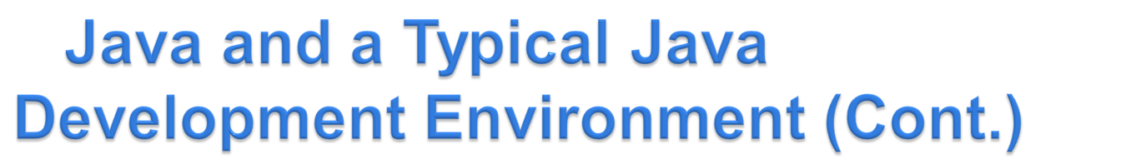
1993
  History: BCPL → C → C++ → Java
  The web exploded in popularity
  Sun saw the potential of using Java to add dynamic content to web pages.
Java is used to develop large-scale enterprise applications, to enhance the functionality of web servers, to provide applications for consumer devices and for many other purposes.
Java Applets are Java based applications running directly on web browsers supporting java compilation (out of scope of this course))
©1992-2012 by Pearson Education, Inc. All Rights Reserved.

Slide 4
Sun Microsystems was acquired by Oracle in 2009.
As of 2010 97% of enterprise desktops, three billion handsets, and 80 million television devices run Java.
Java is the most widely used software development language in the world.
©1992-2012 by Pearson Education, Inc. All Rights Reserved.

Slide 5

Get started quickly: It's easy to learn, especially for programmers already familiar with C or C++.
Write less code: four times smaller code than the same program written in C or C++.
Write better code: Automatic garbage collection helps you avoid memory leaks, so fewer bugs are introduced.
  Powerful Java Class libraries: provides various libraries for built-in functionality for a lot of scenario. Also known as the Java APIs (Application Programming Interfaces).

Slide 6
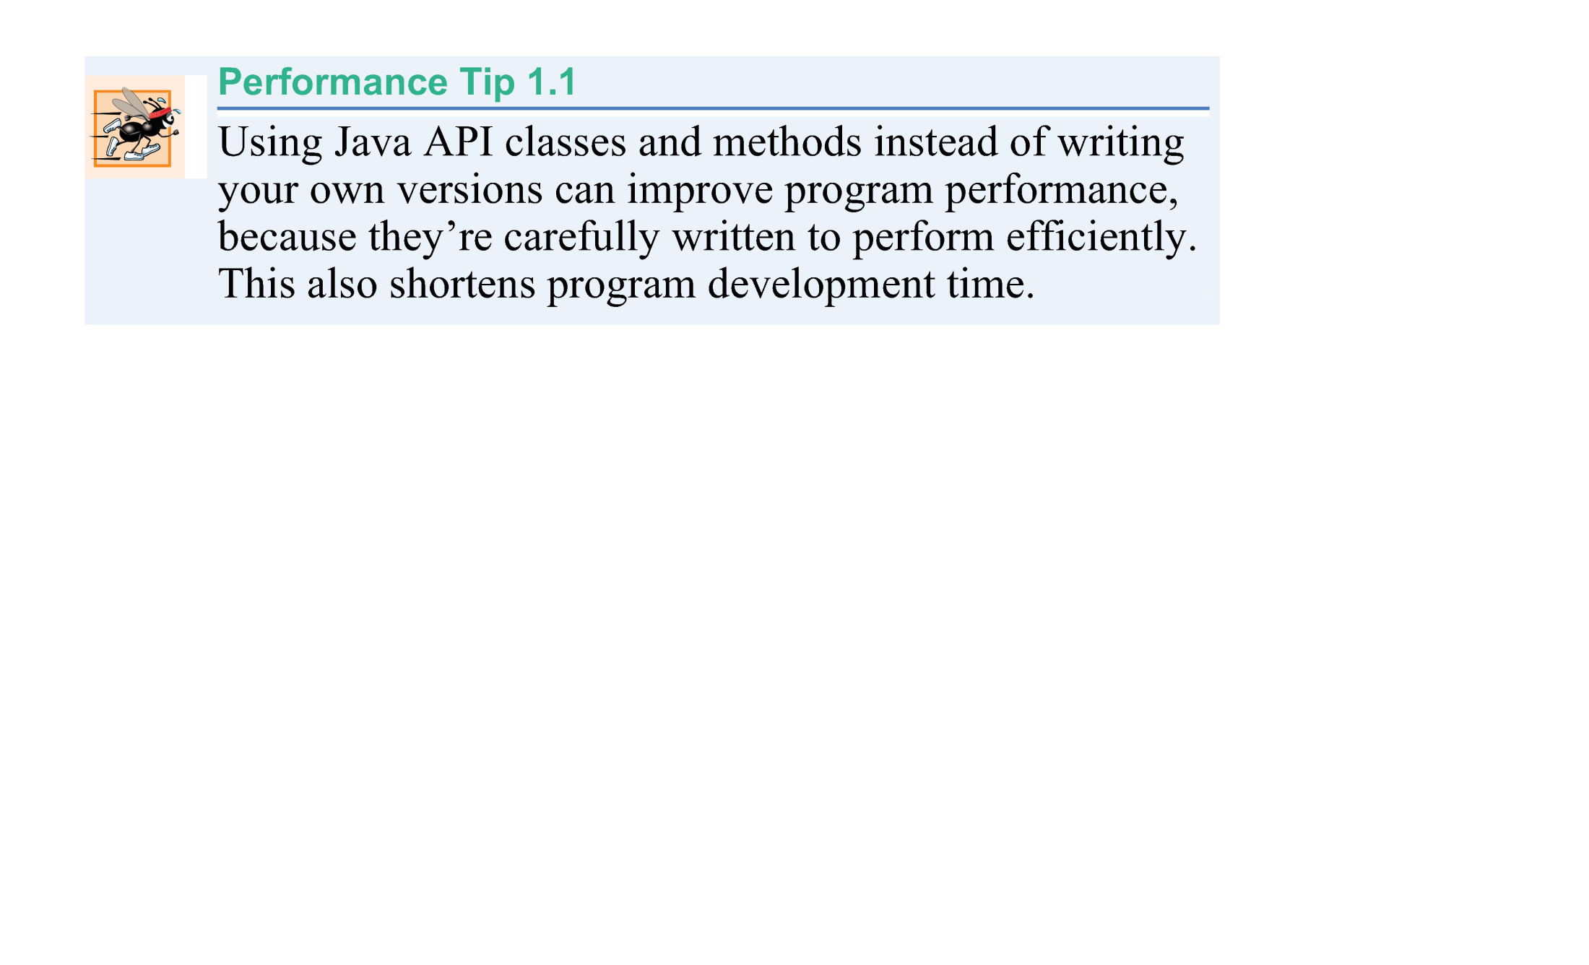
©1992-2012 by Pearson Education, Inc. All Rights Reserved.

Slide 7
It’s object oriented: The support of OOP lets you use powerful OOP features.
Avoid platform dependencies: You can keep your program portable as far as the libraries written in other languages are not required.
Write once, run anywhere: due to the concept of bytecodes, they run consistently on any Java platform.
Wide range of applications: Java is being used in many computing avenues including web, enterprise applications, mobile phones, consumer electronic devices and many more.

Slide 8
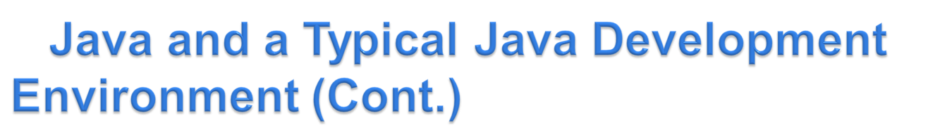
Java programs normally go through five phases
  edit
  compile
  load
  verify
  execute.
©1992-2012 by Pearson Education, Inc. All Rights Reserved.

Slide 9
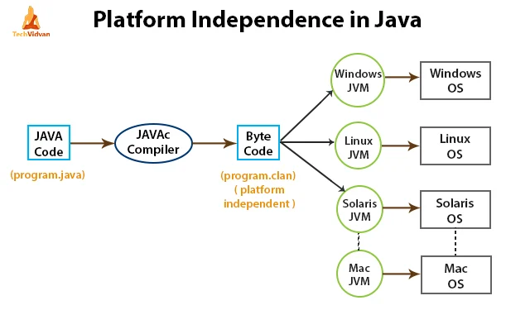
©1992-2012 by Pearson Education, Inc. All Rights Reserved.

Slide 10
Phase 1 consists of editing a file with an editor
  Type a Java program (source code) using the editor.
  Make any necessary corrections.
  Save the program.
  A file name ending with the .java extension indicates that the file contains Java source code.
©1992-2012 by Pearson Education, Inc. All Rights Reserved.

Slide 11
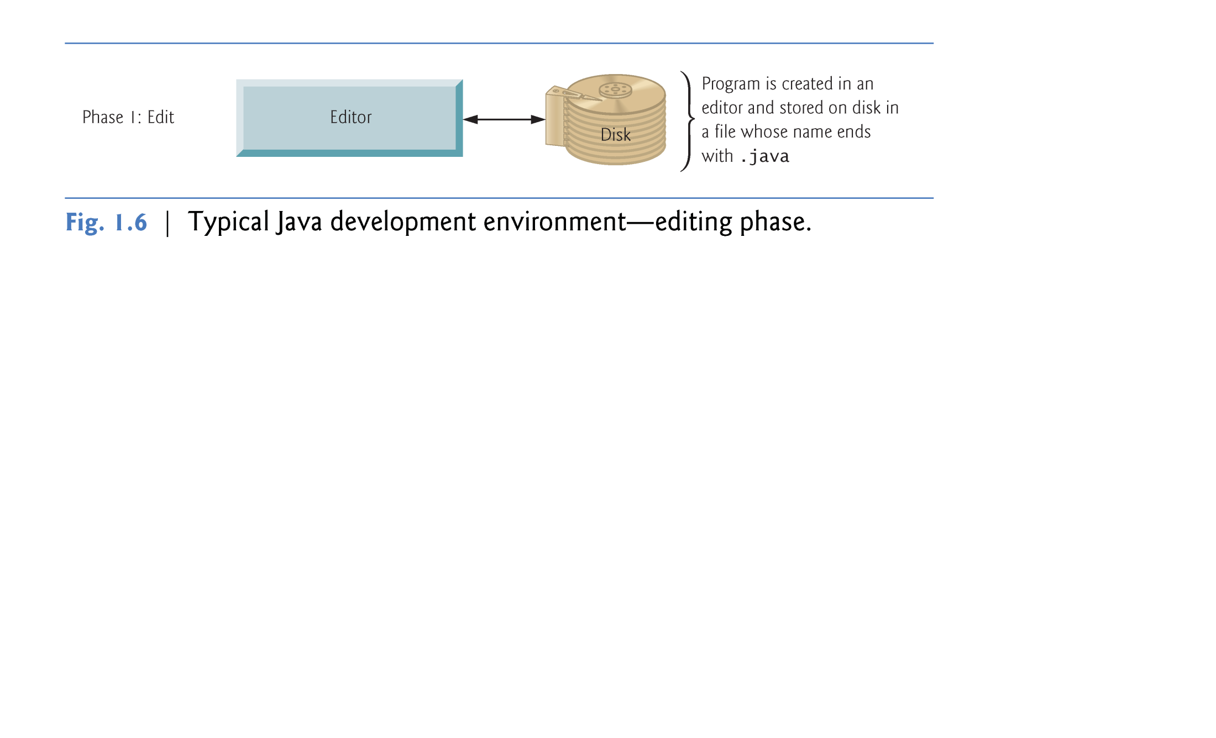
©1992-2012 by Pearson Education, Inc. All Rights Reserved.

Slide 12
Linux editors options: vi and emacs.
Windows editors options:
  Notepad
  EditPlus (www.editplus.com)
  TextPad (www.textpad.com)
  jEdit (www.jedit.org).
Integrated development environments (IDEs)
  Provide tools that support the software development process, including editors for writing and editing programs and debuggers for locating logic errors—errors that cause programs to execute incorrectly.
©1992-2012 by Pearson Education, Inc. All Rights Reserved.

Slide 13
Popular IDEs
  Eclipse (www.eclipse.org)
  IntelliJ IDEA
  NetBeans (www.netbeans.org).
  jGRASP™ IDE (www.jgrasp.org)
  DrJava IDE (www.drjava.org/download.shtml)
  BlueJ IDE (www.bluej.org/)
  TextPad® Text Editor for Windows® (www.textpad.com/)
©1992-2012 by Pearson Education, Inc. All Rights Reserved.

Slide 14

JDK: A set of programs to support java development (also includes JVM and JRE)
Internal & External Versioning
  Current JDK version is 17
  JDK and Java SE will be used synonymously.
  An editor for writing simple java programs with syntax highlighting.
An IDE for developing java projects.
Versions
Major release versions of Java, along with their release dates:
JDK 1.0 (January 23, 1996)
JDK 1.1 (February 19, 1997)
J2SE 1.2 (December 8, 1998)
J2SE 1.3 (May 8, 2000)
J2SE 1.4 (February 6, 2002)
J2SE 5.0 (September 30, 2004)
Java SE 6 (December 11, 2006)
Java SE 7 (July 28, 2011)
Java SE 8 (March 18, 2014)
Java SE 9 (June 30, 2017)
Java SE 10 (March 20, 2018)
Java SE 11 (Sep 25, 2018)
…
Source: https://www.youtube.com/watch?v=EhI0S4s64QQ

Slide 15

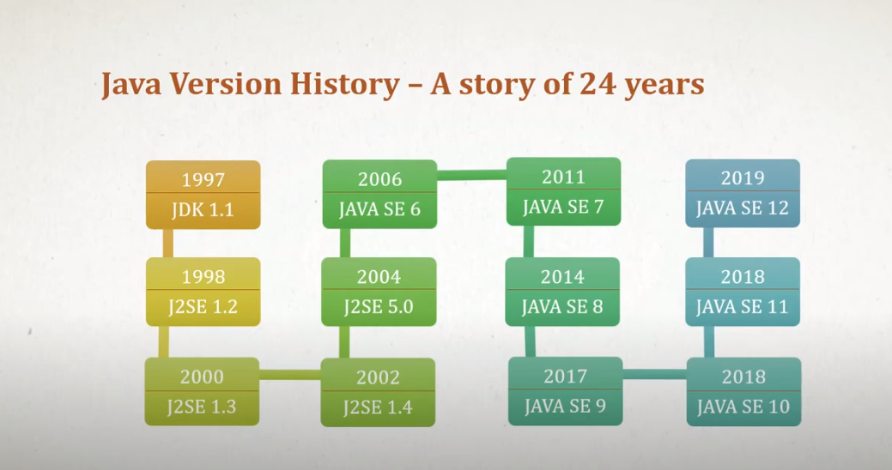
Source: https://www.youtube.com/watch?v=EhI0S4s64QQ

Slide 16

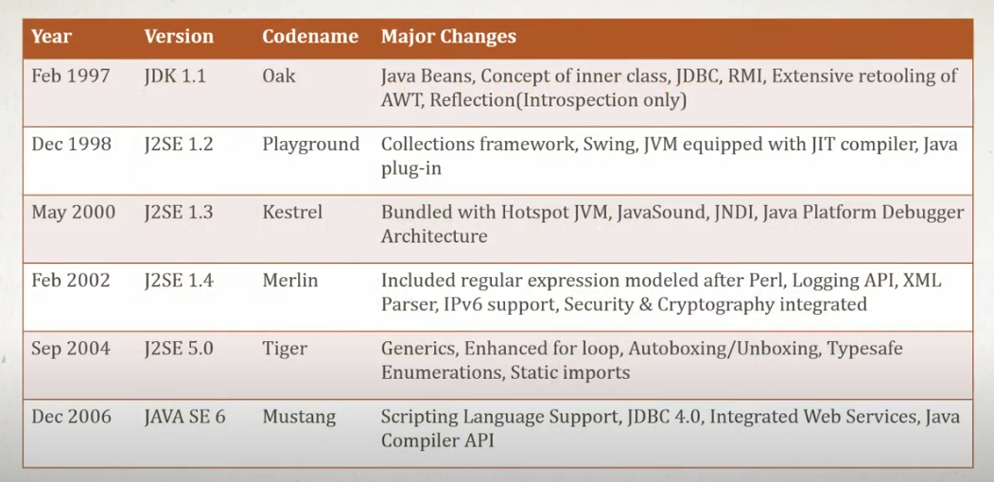
Source: https://www.youtube.com/watch?v=EhI0S4s64QQ

Slide 17
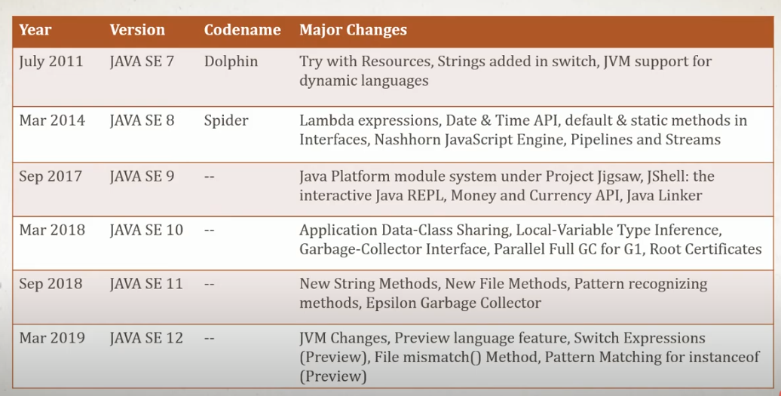
Source: https://www.youtube.com/watch?v=EhI0S4s64QQ

Slide 18

Java Compiler
  Java SE 17 for your version of window
  https://download.oracle.com/java/17/latest/jdk-17_windows-x64_bin.exe
An IDE
  Eclipse eclipse-2021-12: https://www.eclipse.org/downloads/download.php?file=/oomph/epp/2021-12/R/eclipse-inst-jre-win64.exe&mirror_id=105
Installation instructions
  Step 1: Install JDK before installing IDE
  Step 2: Choose the IDE of your choice
Follow the order in installing JDK and its IDE
©1992-2012 by Pearson Education, Inc. All Rights Reserved.

Slide 19
Phase 2: Compiling a Java Program into Bytecodes
  Bytecodes are intermediate code from source code to object (machine language) code
  Use the command javac (the Java compiler) to compile a program. For example, to compile a program called Welcome.java, you’d type
    javac Welcome.java
  If the program compiles, the compiler produces a .class file called Welcome.class that contains the compiled version of the program.
©1992-2012 by Pearson Education, Inc. All Rights Reserved.

Slide 20
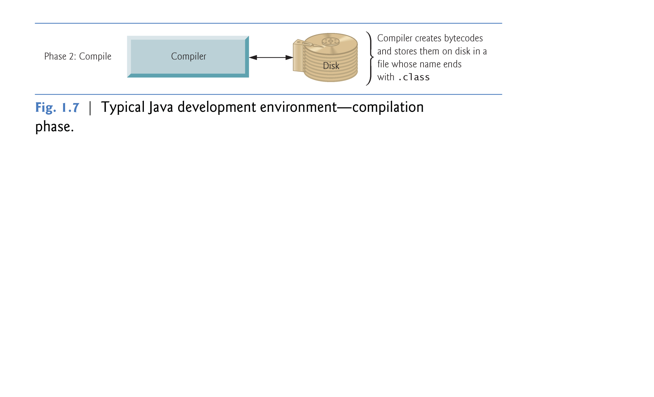
©1992-2012 by Pearson Education, Inc. All Rights Reserved.

Slide 21
Java compiler translates Java source code into bytecodes that represent the tasks to execute.
Bytecodes are executed by the Java Virtual Machine (JVM)—a part of the JDK and the foundation of the Java platform.
Virtual machine (VM)—a software application that simulates a computer
  Hides the underlying operating system and hardware from the programs that interact with it.
If the same VM is implemented on many computer platforms, applications that it executes can be used on all those platforms.
©1992-2012 by Pearson Education, Inc. All Rights Reserved.

Slide 22
Bytecodes are platform independent
  They do not depend on a particular hardware platform.
Bytecodes are portable
  The same bytecodes can execute on any platform containing a JVM that understands the version of Java in which the bytecodes were compiled.
Demo (Java Portability & Platform independence): https://www.youtube.com/watch?v=RZ3vXsI1vDU
The JVM is invoked by the java command. For example, to execute a Java application called Welcome, you’d type the command
    java Welcome
No .class should be used with the file name here
©1992-2012 by Pearson Education, Inc. All Rights Reserved.

Slide 23
Phase 3: Loading a Program into Memory
  The JVM places the program in memory to execute it—this is known as loading.
  Class loader takes the .class files containing the program’s bytecodes and transfers them to primary memory.
  Also loads any of the .class files provided by Java that your program uses.
The .class files can be loaded from a disk on your system or over a network.
©1992-2012 by Pearson Education, Inc. All Rights Reserved.

Slide 24
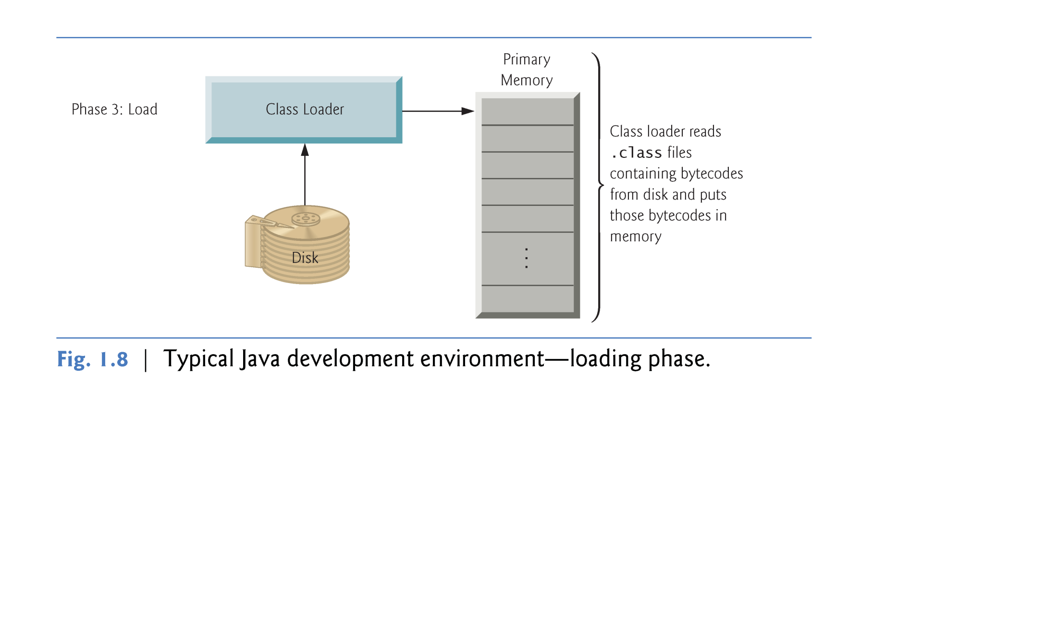
©1992-2012 by Pearson Education, Inc. All Rights Reserved.

Slide 25
Phase 4: Bytecode Verification
  As the classes are loaded, the bytecode verifier examines their bytecodes
  Ensures that they’re valid and do not violate Java’s security restrictions.
Java enforces strong security to make sure that Java programs arriving over the network do not damage your files or your system (as computer viruses and worms might).
©1992-2012 by Pearson Education, Inc. All Rights Reserved.

Slide 26
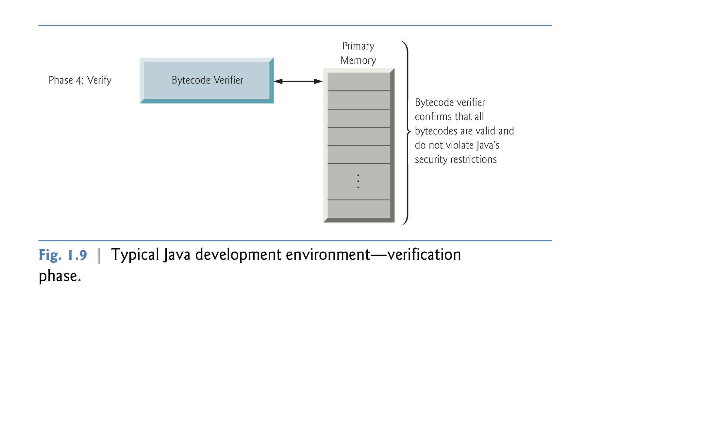
©1992-2012 by Pearson Education, Inc. All Rights Reserved.

Slide 27
Phase 5: Execution
  The JVM executes the program’s bytecodes.
  JVMs typically execute bytecodes using a combination of interpretation and so-called just-in-time (JIT) compilation.
  Analyzes the bytecodes as they’re interpreted
  A just-in-time (JIT) compiler—known as the Java HotSpot compiler—translates the bytecodes into the underlying computer’s machine language at execution time.
©1992-2012 by Pearson Education, Inc. All Rights Reserved.

Slide 28
  When the JVM encounters these compiled parts again, the faster machine-language code executes.
  In short, Java programs go through two compilation phases
    One in which source code is translated into bytecodes (for portability across JVMs on different computer platforms) and
    A second in which, during execution, the bytecodes are translated into machine language for the actual computer on which the program executes.
©1992-2012 by Pearson Education, Inc. All Rights Reserved.

Slide 29
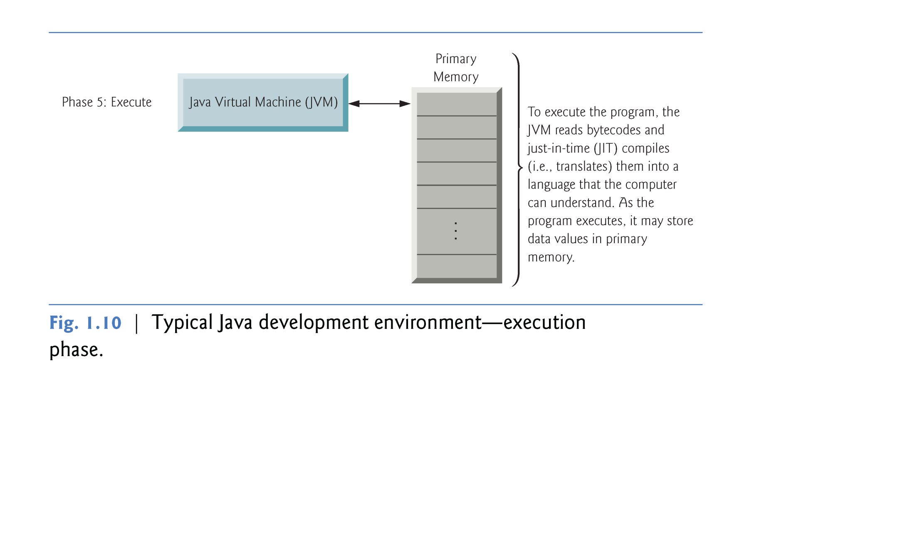
©1992-2012 by Pearson Education, Inc. All Rights Reserved.

